Slide 1
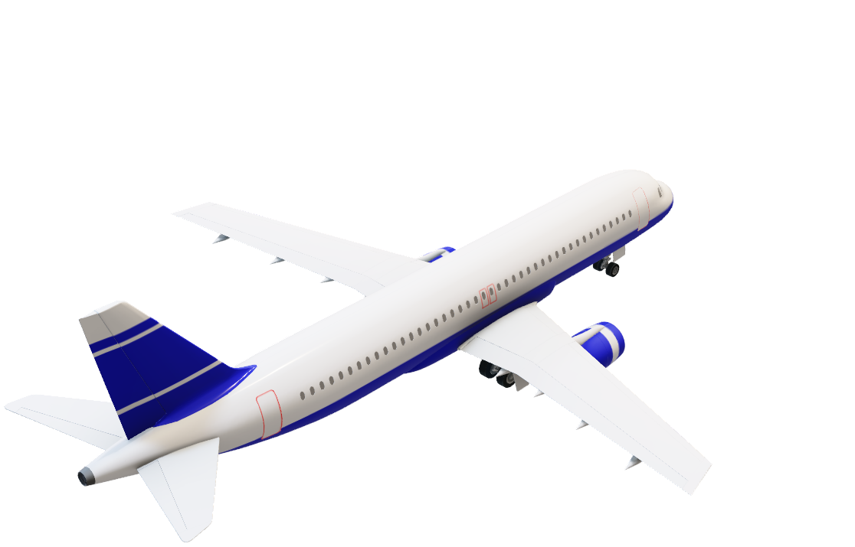
High Cloud Airline Analysis Report
Presentation by Group 5
DHIRAJ KADAM
GANESH CHAUDHARI
RAHUL PHUKE
SANKET SAVARKAR

Slide 2
Objective
This presentation provides an analysis of High Cloud Airlines' operations using data insights.
High Cloud Airlines data gives you insight about airlines operating across multiple countries and cities, serving millions of passengers worldwide.
The goal is to understand passenger trends, airline efficiency, and key business opportunities.

Slide 3

Challenges Faced During Data cleaning
Inconsistent Formatting: Standardized date formats and column names.
- Removed '%' symbols to make names clearer.
- Created a new Date column by combining Day, Month, and Year.
Missing Values: Some records lacked passenger or airline data, requiring imputation.
Incorrect Data Types: Passenger counts or flight durations stored as text instead of numbers needed conversion.

Slide 4

Visualization Insights
Passenger Traffic & Market Share
Load Factor Efficiency
Top Carriers:
Southwest Airlines Co. (34M passengers) and Delta Air Lines Inc. (29M passengers) dominate the market.
Understanding this distribution helps us identify key players in the industry.
Overall Load Factor: 76.8% across all airlines.
Peak Months: June (81.5%), July (80.6%) indicate strong seasonal demand.
Low Month: January (69.7%) shows weak travel demand.
Business Decision: We can Adjust pricing and promotions based on seasonal demand to maximize revenue.

Slide 5
Visualization Insights
Weekday vs. Weekend Load Factor
Flight Distance & Route Optimization
Weekday Load Factor: 71.2%, indicating strong business travel.
Weekend Load Factor: 28.8%, showing lower leisure travel engagement.
Business Decision: Develop weekend promotions, discounts, or packages to encourage leisure travel.
Short-haul flights (<500 miles): 58K flights, indicating regional dominance.
Long-haul flights (>1500 miles): Less than 10K, showing low international market penetration.
Business Decision: We can Expand long-haul flights to increase international market share and revenue.

Slide 6
Visualization Insights
Best Performing Airlines by Load Factor
Travel Destination Insights
Top Performers: Global Airways Limited (95%), Allegiant Air (89%), XL Airways France (88%).
Business Decision: We can Benchmark these airlines to optimize operational efficiency and seat occupancy of other Airlines.
United States: 173M passengers dominate the market.
Other top destinations: Mexico (2M), Canada (1M), UK (1M), Japan (1M).
Business Decision: We can Diversify marketing efforts to attract international travelers and increase market reach.

Slide 7
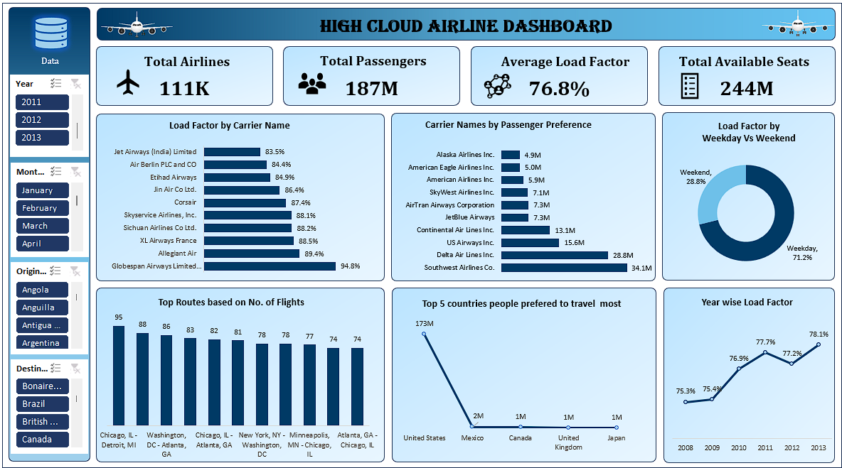

Slide 8
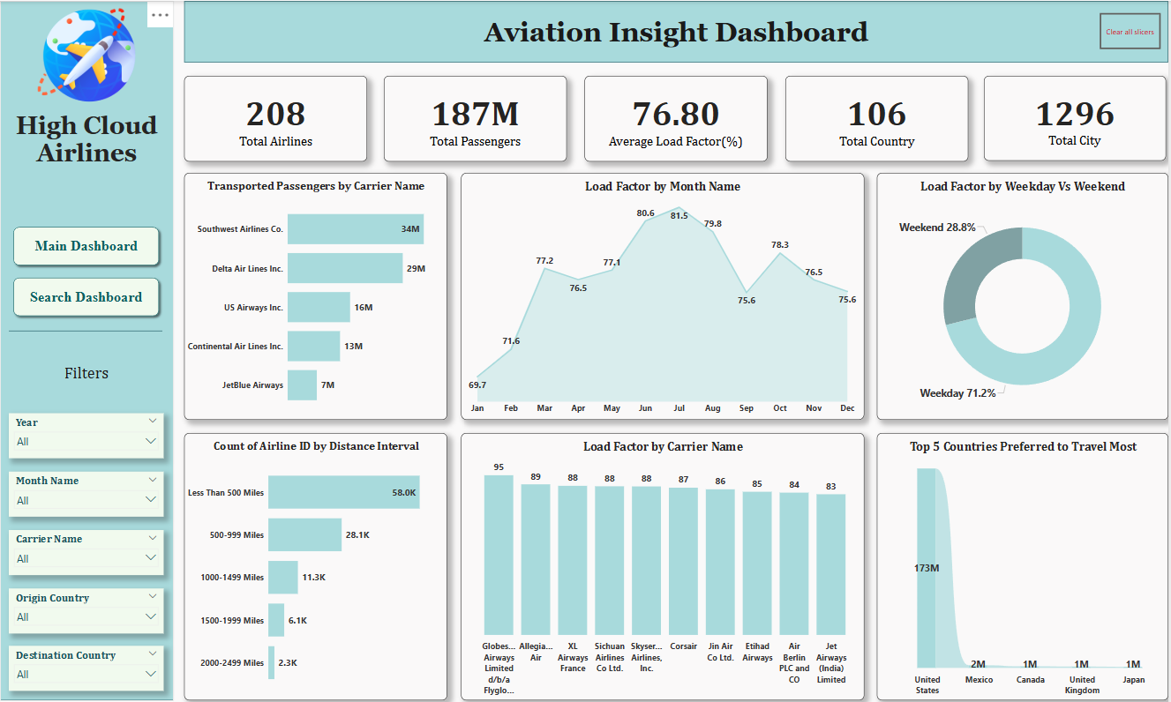

Slide 9
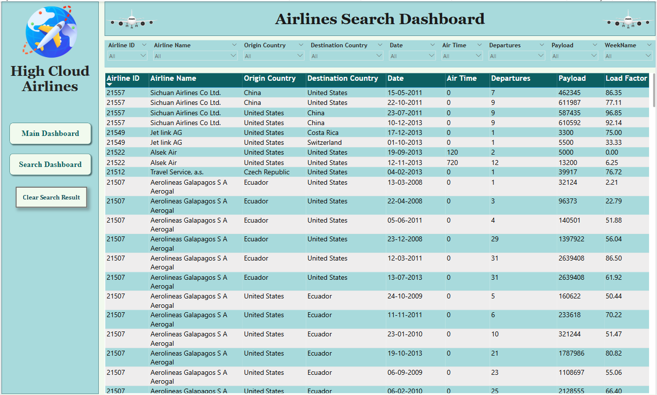

Slide 10
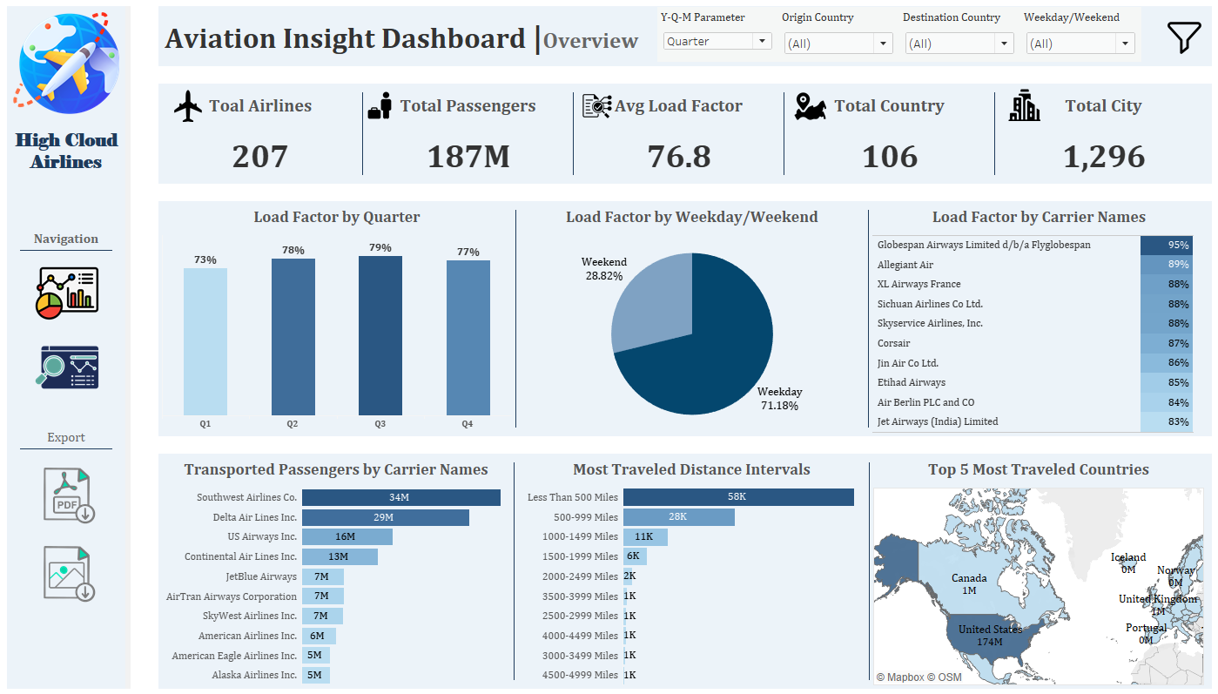

Slide 11
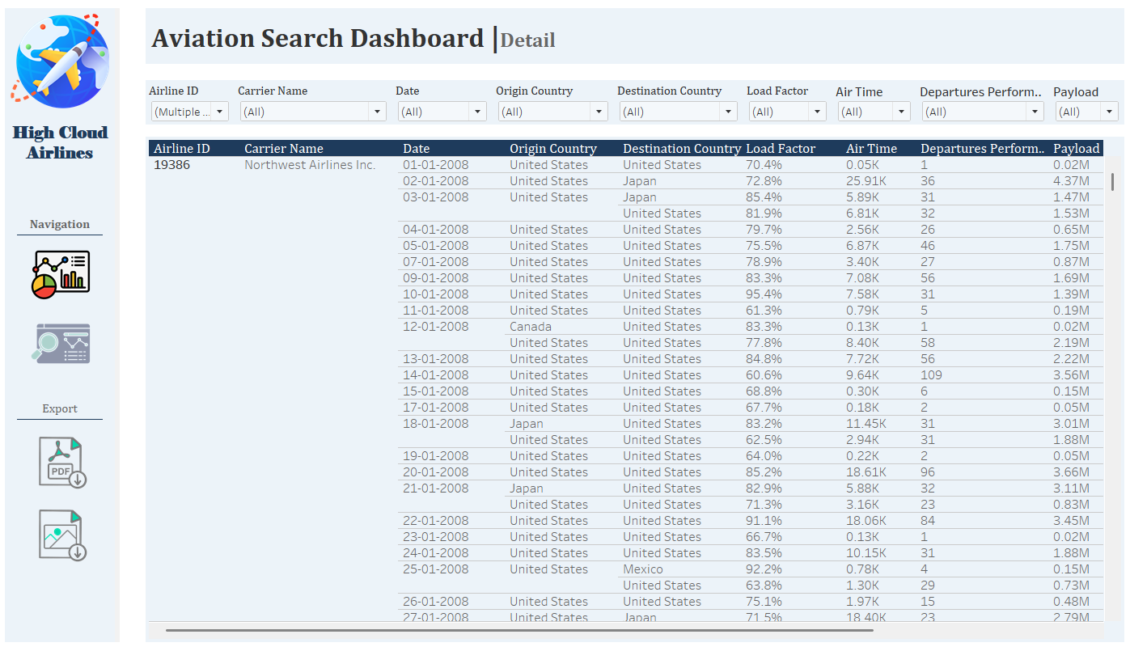

Slide 12
Conclusion & Recommendations
Key Takeaways
Recommendations
The U.S. dominates passenger traffic, with significantly higher volumes than other countries.
Load factors are highest in mid-year months, suggesting seasonal demand trends.
Airlines with the highest load factors optimize seat occupancy efficiently.
Short-haul flights dominate the market, indicating regional travel preference
Expand Long-Haul Operations: Increase flights over 1,500 miles to capture international demand.
Improve Weekend Load Factors: Implement weekend travel incentives to balance weekday-weekend traffic.
Enhance Market Reach: Promote travel to underrepresented destinations to diversify passenger flow.
Optimize Peak Travel Periods: Adjust pricing and capacity strategies for maximum efficiency in high-load months.

Slide 13
Conclusion
High Cloud Airlines' business insights highlight key opportunities to enhance market performance and operational efficiency.
The data-driven approach suggests focusing on expanding long-haul routes, optimizing pricing strategies, and improving weekend travel engagement.
Additionally, benchmarking against top-performing airlines and targeting international markets can drive sustainable growth.
By implementing these strategic decisions, High Cloud Airlines can strengthen its competitive position and maximize profitability in the aviation industry.

Slide 14
Thank You

